Slide 1
목차
Dataset
Data preprocessing
Model preprocessing
U-Net 기반 Backbone (encoding) network 간 차이
Resnet50 backbone 기반 Network 간 차이
VGG16 backbone 기반 Network 간 차이
GoogleNet(InceptionNet) 기반 Network 간 차이

Slide 2
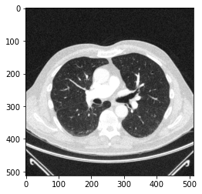
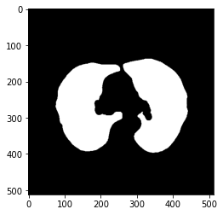
Dataset
A collection of CT images, manually segmented lungs and measurements in 2D
https://www.kaggle.com/kmader/finding-lungs-in-ct-data/codeNetwork
# of Data: 267
Width: 256 px
Height: 256 px
Channel: 1
image
mask

Slide 3

Data preprocessing
CT Windowing
W = 1500, L = -600
Data Normalization
X = $\frac{X − X_{min}}{{X }_{max} − X_{min}}$
Train Test split
133 of training data
134 of test data
Data Augmentation
width shift range = 0.1
height shift range = 0.1
rotation range = 10
zoom range = 0.1

Slide 4
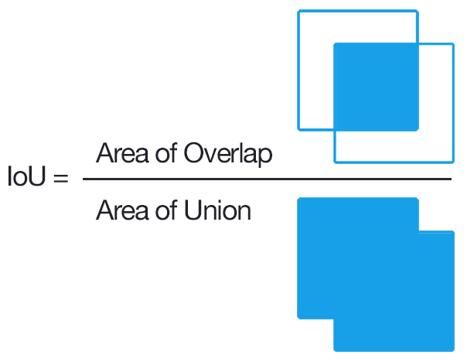
Model preprocessing
Optimizer
Adam
Loss function
Bce Jaccard Loss
Callbacks
Reduce LR on Plateau
(factor=0.1, patience = 3, min_lr = 1e-5)
Epochs, Batch size
epochs = 100, batch size = 8,
steps per epoch = 20

Slide 5
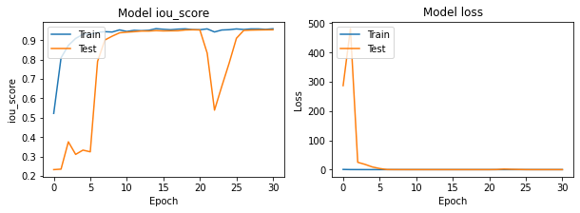
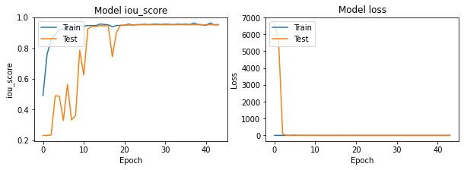
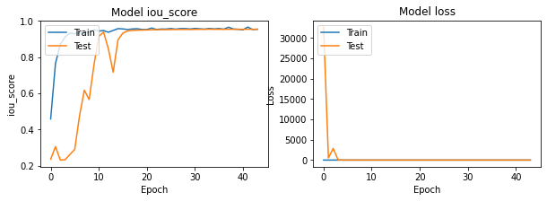
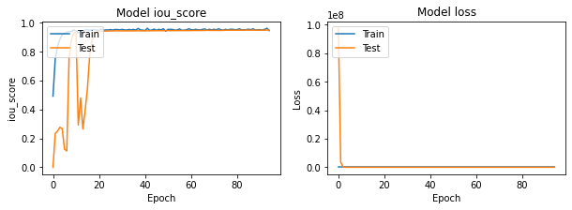
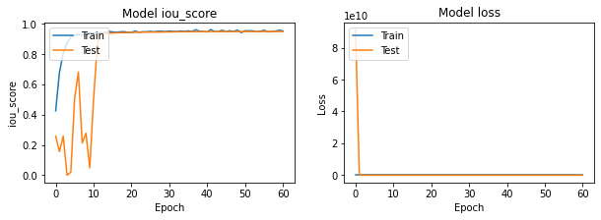
U-Net with backbones
Resnet18
Resnet34
Resnet50
Resnet101
Resnet152

Slide 6
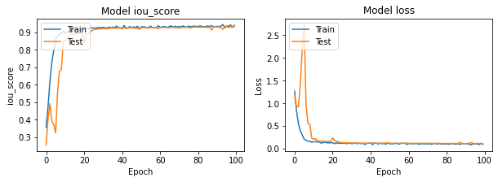
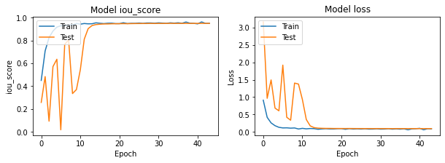
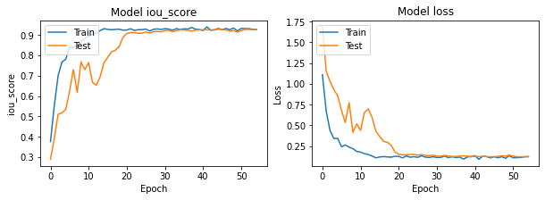
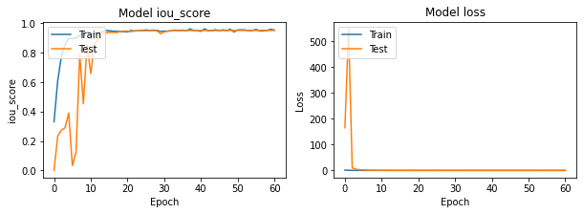
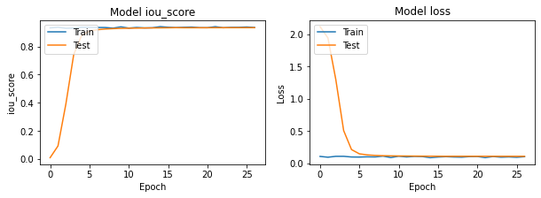
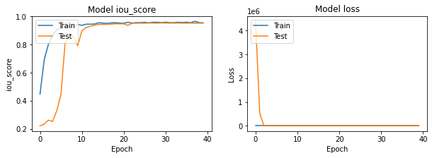
U-Net with backbones
VGG16
EfficientB0
VGG19
EfficientB7
Inceptionv3
Senet154
* 초기값 세팅 굉장히 오래 걸림

Slide 7
U-Net with backbones
Lung Data
Ground Truth
Resnet18
Resnet34
Resnet50

Slide 8
U-Net with backbones
Lung Data
Ground Truth
Resnet101
Resnet152

Slide 9
U-Net with backbones
Lung Data
Ground Truth
VGG16
VGG19
Inceptionv3

Slide 10
U-Net with backbones
Lung Data
Ground Truth
EfficientB0
EfficientB7
Senet154

Slide 11
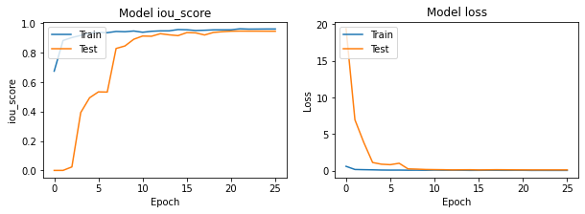
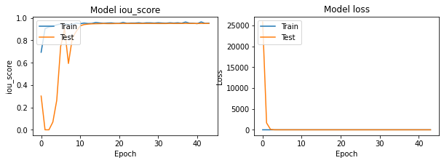
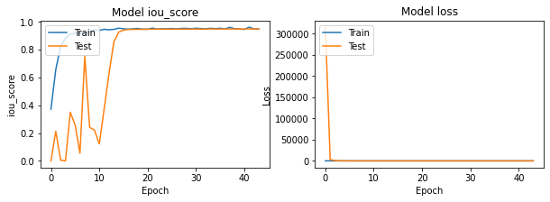
Networks with resnet50
U-Net
PSPNet
FPN
Linknet

Slide 12
Networks with resnet50
Ground Truth
U-Net
FPN
Linknet
PSPNet

